Slide 1
Exception Handling

Slide 2
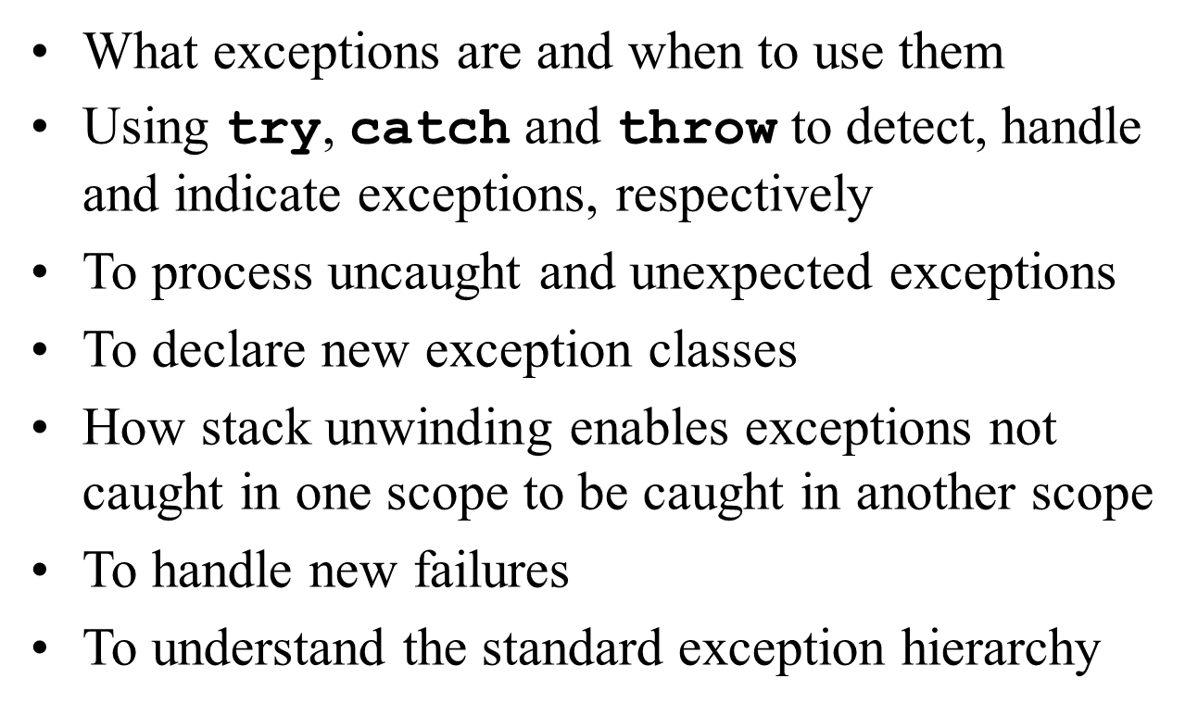
Agenda

Slide 3
Fundamental Philosophy
•Mechanism for sending an exception signal up the call stack
•Regardless of intervening calls
•Note: there is a mechanism based on same philosophy in C
•setjmp(), longjmp()
•More available in man pages

Slide 4
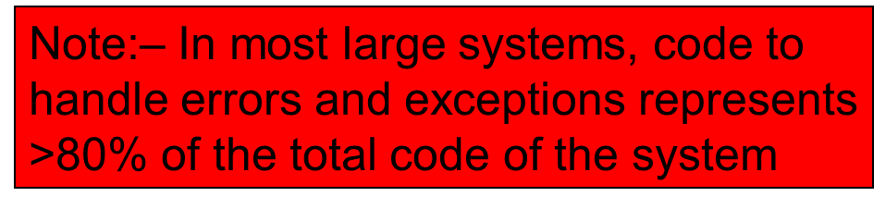
Traditional Exception Handling
•Intermixing program and error-handling logic
–Pseudocode outline
Perform a task
If the preceding task did not execute correctly
Perform error processing
Perform next task
If the preceding task did not execute correctly
Perform error processing
…
•Makes the program difficult to read, modify, maintain and debug
•Impacts performance

Slide 5
Fundamental Philosophy (continued)
•Remove error-handling code from the program execution’s “main line”
•
•Programmers can handle any exceptions they choose
–All exceptions
–All exceptions of a certain type
–All exceptions of a group of related types

Slide 6
Fundamental Philosophy (continued)
•Programs can
–Recover from exceptions
–Hide exceptions
–Pass exceptions up the “chain of command”
–Ignore certain exceptions and let someone else handle them

Slide 7
Fundamental Philosophy (continued)
•An exception is a class
•Usually derived from one of the system’s exception base classes
•If an exceptional or error situation occurs, program throws an object of that class
•Object crawls up the call stack
•A calling program can choose to catch exceptions of certain classes
•Take action based on the exception object

Slide 8
Class Exception
•The standard C++ base class for all exceptions
•Provides derived classes with virtual function what
–Returns the exception’s stored error message

Slide 9
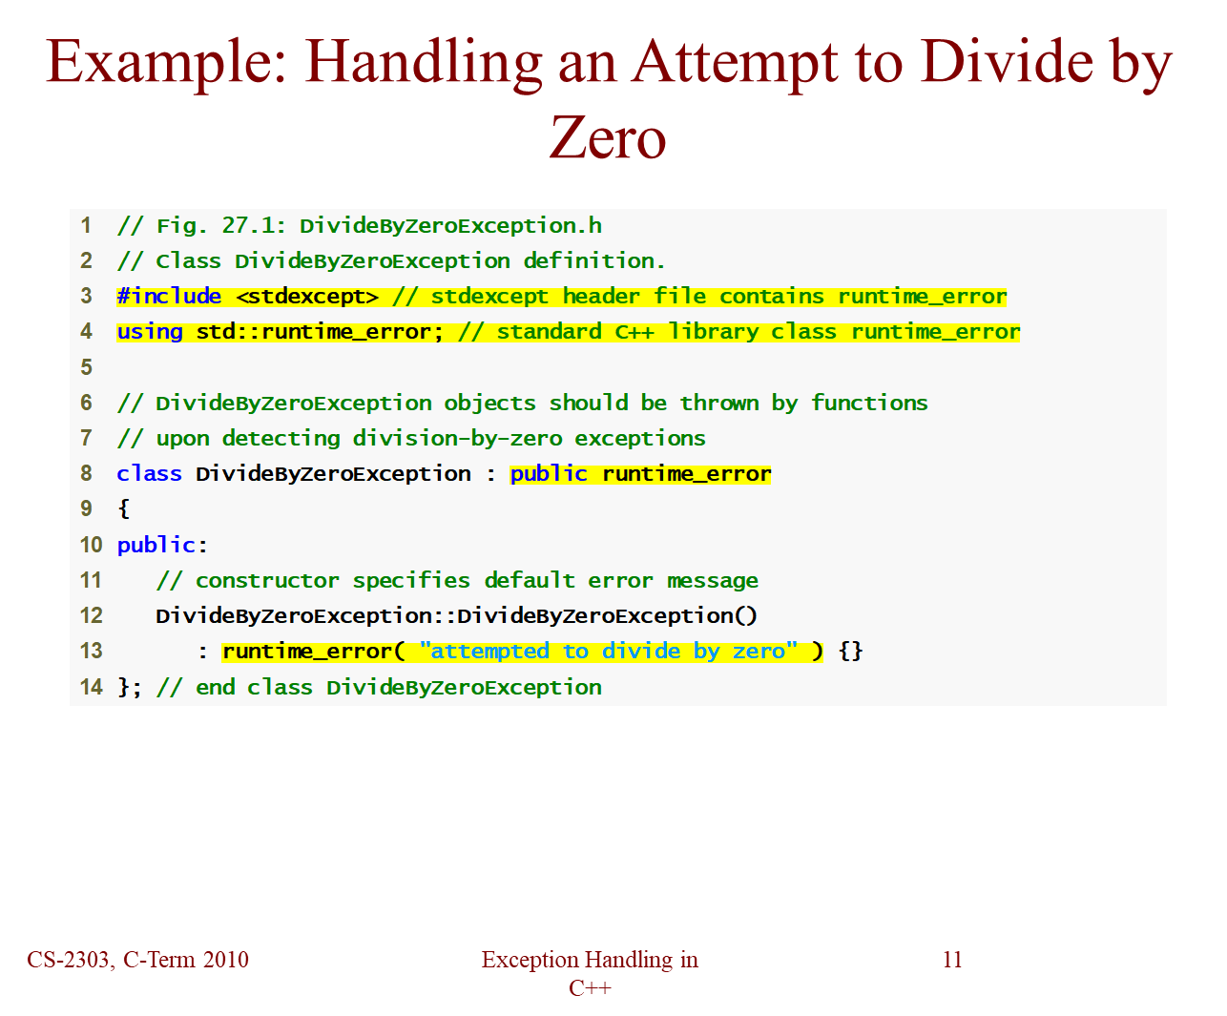
Example:Handling an Attempt to Divide by Zero

Slide 10
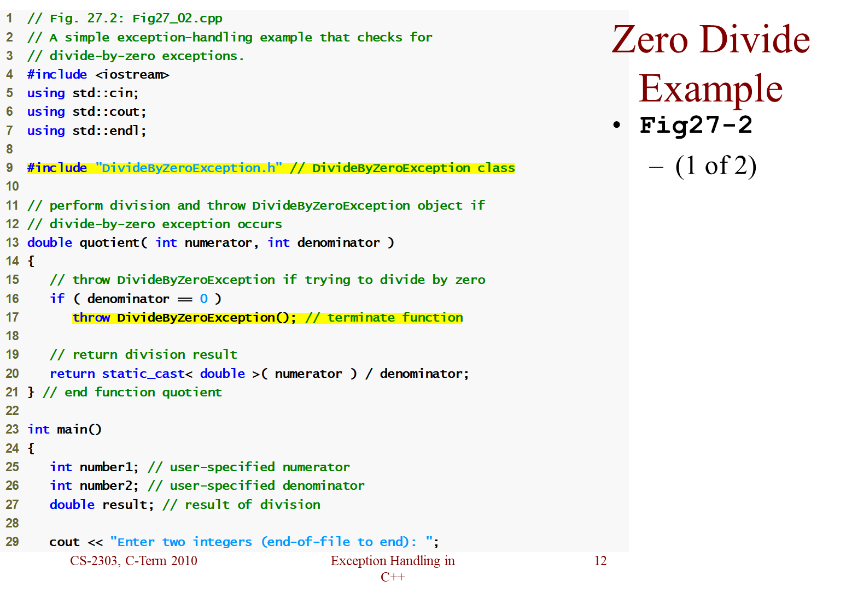

Slide 11
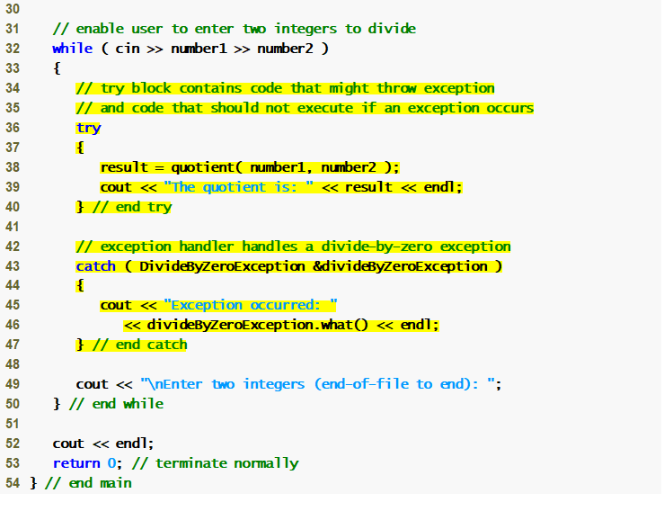

Slide 12
Try Blocks
•Keyword try followed by braces ({})
•Should enclose
–Statements that might cause exceptions
–Statements that should be skipped in case of an exception

Slide 13
Software Engineering Observations
•Exceptions may surface
–through explicitly mentioned code in a try block,
–through calls to other functions and
–through deeply nested function calls initiated by code in a try block.

Slide 14
Catch Handlers
•Immediately follow a try block
–One or more catch handlers for each try block
•Keyword catch
•Exception parameter enclosed in parentheses
–Represents the type of exception to process
–Can provide an optional parameter name to interact with the caught exception object
•Executes if exception parameter type matches the exception thrown in the try block
–Could be a base class of the thrown exception’s class

Slide 15
Catch Handlers (continued)
try { // code to try
}
catch (exceptionClass1 &name1) { // handle exceptions of exceptionClass1
}
catch (exceptionClass2 &name2) { // handle exceptions of exceptionClass2
}
catch (exceptionClass3 &name3) { // handle exceptions of exceptionClass3
}
...
/* code to execute if
no exception or catch handler handled exception*/

Slide 16
Common Programming Errors
Syntax error to place code between a try block and its corresponding catch handlers
•
Each catch handler can have only a single parameter
•Specifying a comma-separated list of exception parameters is a syntax error
•Logic error to catch the same type in two different catch handlers following a single try block

Slide 17
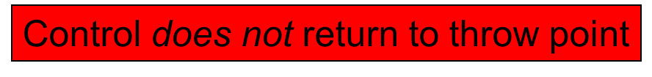
Fundamental Philosophy (continued)
•Termination model of exception handling
–try block expires when an exception occurs
•Local variables in try block go out of scope
–Code within the matching catch handler executes
–Control resumes with the first statement after the last catch handler following the try block
•
•Stack unwinding
–Occurs if no matching catch handler is found
–Program attempts to locate another enclosing try block in the calling function

Slide 18
Stack Unwinding
•Occurs when a thrown exception is not caught in a particular scope
•Unwinding a Function terminates that function
–All local variables of the function are destroyed
•Invokes destructors
–Control returns to point where function was invoked
•Attempts are made to catch the exception in outer try…catch blocks
•If the exception is never caught, the function terminate is called

Slide 19
Observations
With exception handling, a program can continue executing (rather than terminating) after dealing with a problem.
–
This helps to support robust applications that contribute to mission-critical computing or business-critical computing
–
When no exceptions occur, there is no performance penalty

Slide 20
Throwing an Exception
•Use keyword throw followed by an operand representing the type of exception
–The throw operand can be of any type
–If the throw operand is an object, it is called an exception object
•The throw operand initializes the exception parameter in the matching catch handler, if one is found

Slide 21
Observations
•Catching an exception object by reference eliminates the overhead of copying the object that represents the thrown exception
•
•Associating each type of runtime error with an appropriately named exception object improves program clarity.

Slide 22
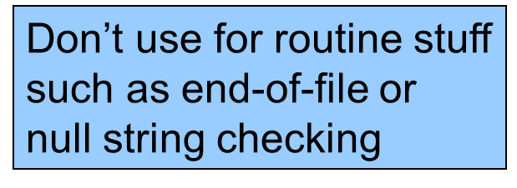
When to use Exception Handling
•To process synchronous errors
–Occur when a statement executes
•Not to process asynchronous errors
–Occur in parallel with, and independent of, program execution
•To process problems arising in predefined software elements
–Such as predefined functions and classes
–Error handling can be performed by the program code to be customized based on the application’s needs

Slide 23
Rethrowing an Exception
•Empty throw; statement
•Use when a catch handler cannot or can only partially process an exception
•
•Next enclosing try block attempts to match the exception with one of its catch handlers

Slide 24
Common Programming Error
Executing an empty throw statement outside a catch handler causes a function call to terminate
•Abandons exception processing and terminates the program immediately

Slide 25
Constructors and Destructors
•Exceptions and constructors
–Exceptions enable constructors to report errors
•Unable to return values
–Exceptions thrown by constructors cause any already-constructed component objects to call their destructors
•Only those objects that have already been constructed will be destructed
•Exceptions and destructors
–Destructors are called for all automatic objects in the terminated try block when an exception is thrown
•Acquired resources can be placed in local objects to automatically release the resources when an exception occurs
–If a destructor invoked by stack unwinding throws an exception, function terminate is called

Slide 26
Exceptions and Inheritance
•New exception classes can be defined to inherit from existing exception classes
•A catch handler for a particular exception class can also catch exceptions of classes derived from that class
•Enables catching related errors with a concise notation

Slide 27
Failures of call to new()
•Some compilers throw a bad_alloc exception
–Compliant to the C++ standard specification
•Some compilers return 0
–C++ standard-compliant compilers also have a version of new that returns 0
•Use expression new( nothrow ), where nothrow is of type nothrow_t
•Some compilers throw bad_alloc if <new> is included

Slide 28
Standard Library Exception Hierarchy
•Base-class exception
–Contains virtual function what for storing error messages
•Exception classes derived from exception
–bad_alloc – thrown by new
–bad_cast – thrown by dynamic_cast
–bad_typeid – thrown by typeid
–bad_exception – thrown by unexpected
•Instead of terminating the program or calling the function specified by set_unexpected
•Used only if bad_exception is in the function’s throw list

Slide 29
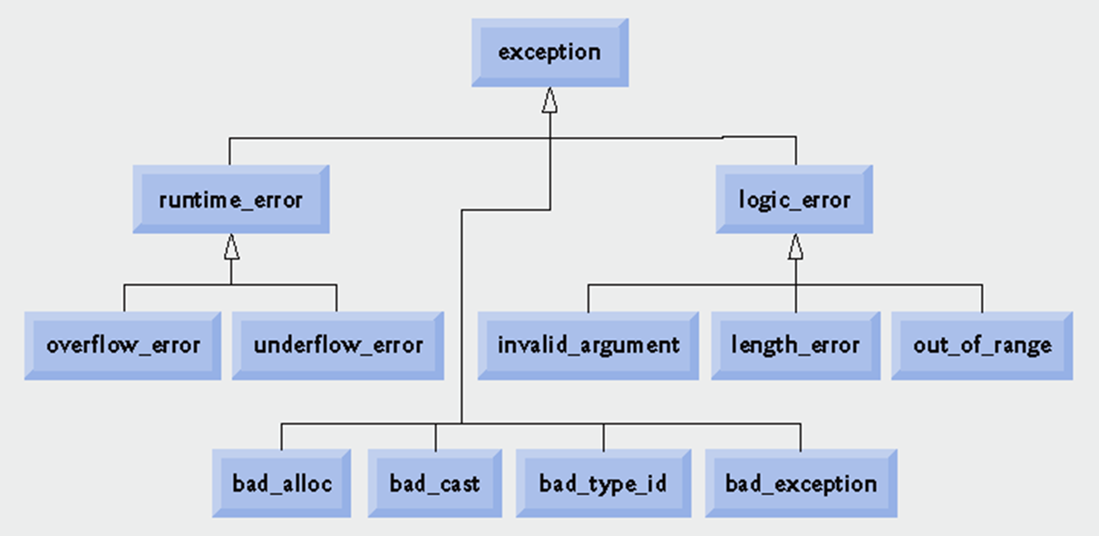
Standard Library Exception

Slide 30
Programming Exercises
(Throwing the Result of a Conditional Expression) Throw the result of a conditional expression that returns either a double or an int. Provide an int catch handler and a double catch handler. Show that only the double catch handler executes, regardless of whether the int or the double is returned.
(Local Variable Destructors) Write a program illustrating that all destructors for objects constructed in a block are called before an exception is thrown from that block
(Member Object Destructors) Write a program illustrating that member object destructors are called for only those member objects that were constructed before an exception occurred.

